Slide 1
Welcome to INFO1112!
Tutorial 1

Slide 2


Acknowledgement of Country
I would like to acknowledge the Traditional Owners of the land on which we meet today, the Gadigal People of the Eora Nation, and pay my respects to Elders past, present and emerging.
I’d like to pay my respects their continuing connection to land, water and culture.
I’d like to acknowledge any First Nations people who may be present today.

Slide 3
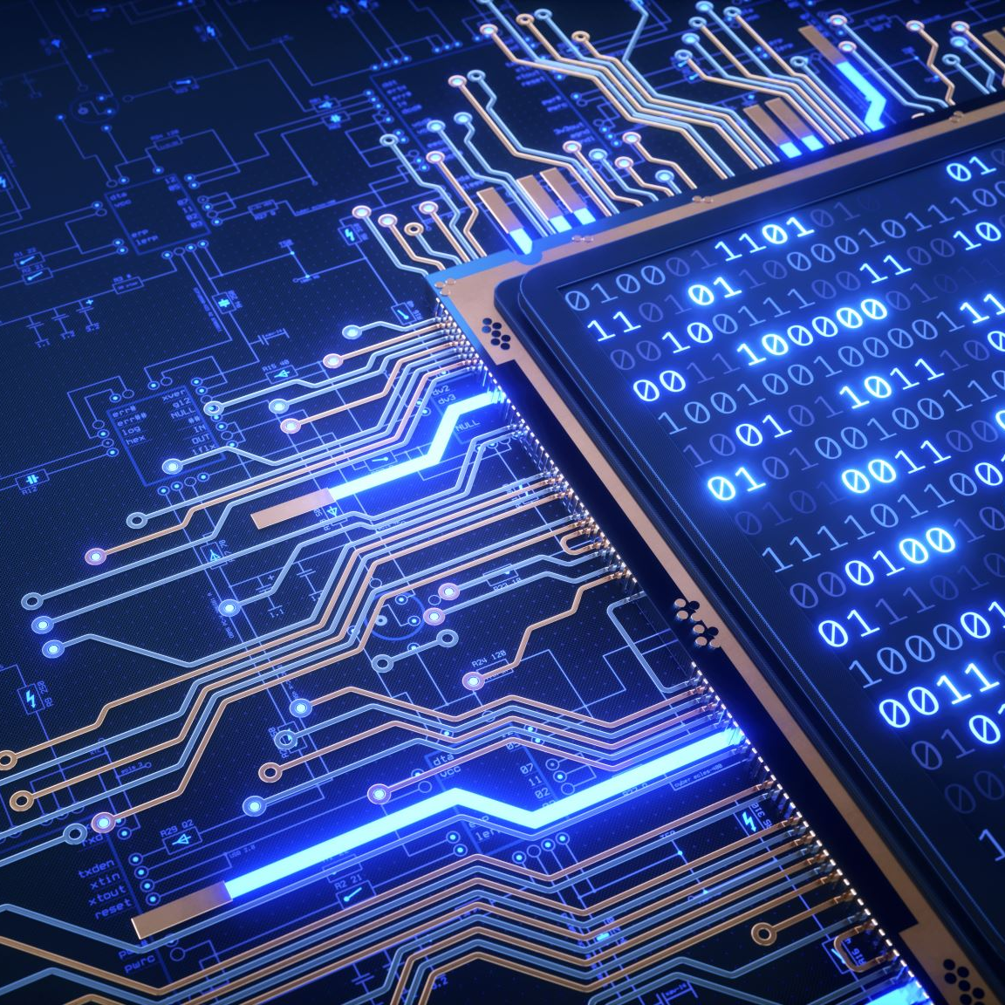
About me
Name: Ashton Liu
Degree: Bachelor of Advanced Computing/Bachelor of Commerce
Majors: Computer Science/Finance
Hobbies: Games, Sport, Philosophy

Slide 4
Get to know time (and attendance)!
Name
What degree you’re doing
Something interesting you did over the holidays

Slide 5

Welcome to INFO1112!
Broad unit of study covering many topics about computing
Opportunity to develop skills in operating systems, computer design, networking, coding
A lot of information will come up in a lot of majors later on!

Slide 6
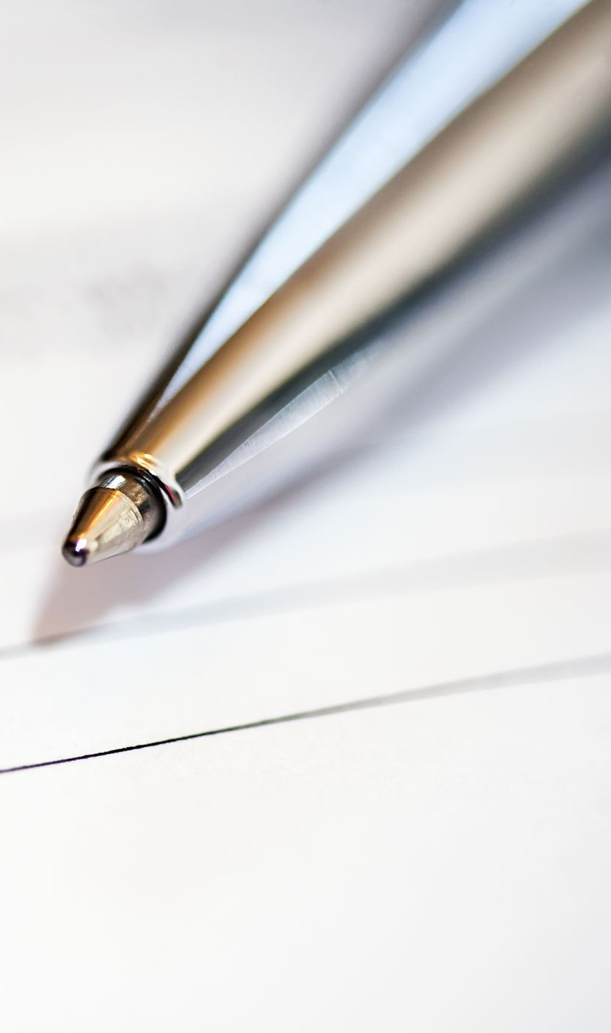
Brief summary of this week’s content

Slide 7
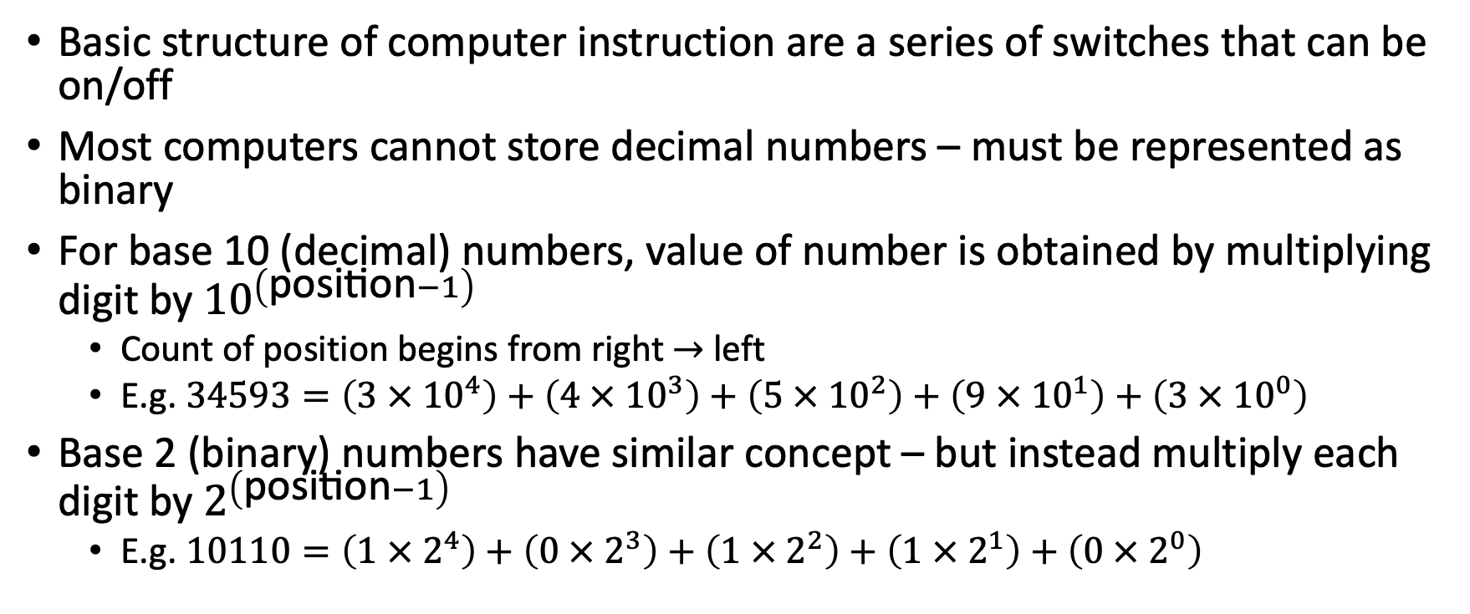
1.1 – Binary Numbers
Basic structure of computer instruction are a series of switches that can be on/off
Most computers cannot store decimal numbers – must be represented as binary
For base 10 (decimal) numbers, value of number is obtained by multiplying digit by ${10}^{\left(\text{position}−1\right)}$
Count of position begins from right $→$ left
E.g. $34593=\left(3 × {10}^{4}\right)+\left(4 × {10}^{3}\right)+\left(5 × {10}^{2}\right)+\left(9 × {10}^{1}\right)+\left(3 × {10}^{0}\right)$
Base 2 (binary) numbers have similar concept – but instead multiply each digit by $2^{\left(\text{position}−1\right)}$
E.g. $10110=\left(1 × 2^{4}\right)+\left(0 × 2^{3}\right)+\left(1 × 2^{2}\right)+\left(1 × 2^{1}\right)+\left(0 × 2^{0}\right)$

Slide 8
1.1 – Binary Numbers
Binary | Decimal | Hexadecimal
0000 | 0 | 0
0001 | 1 | 1
0010 | 2 | 2
0011 | 3 | 3
0100 | 4 | 4
0101 | 5 | 5
0110 | 6 | 6
0111 | 7 | 7
1000 | 8 | 8
1001 | 9 | 9
1010 | 10 | A
1011 | 11 | B
1100 | 12 | C
1101 | 13 | D
1110 | 14 | E
1111 | 15 | F
Hexadecimal (base 16) numbers can be used to save space when writing binary numbers
Group binary number into groups of 4 bits from right to left (pad with 0s on leftmost group if needed)
Change each group into corresponding hexadecimal digit based on its numerical value
Doesn’t save space in computer, but can be more compact + easier to read for humans

Slide 9
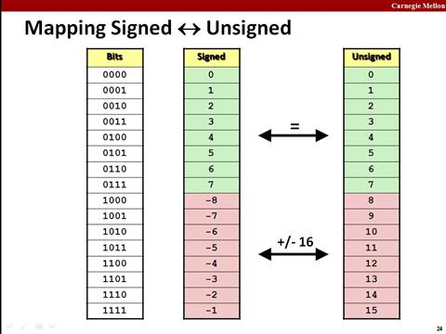
1.2 – Number Representations
Integers (whole numbers)
Unsigned (non-negative) – same as binary representation shown before
Signed approaches:
Includes one’s complement and (most commonly) two’s complement
Not covered in this course, but ELEC1601 delves into more detail

Slide 10
1.3 – Character Representations
In computers, specific numbers map to a character depending on the encoding
Historically, ASCII was common standard for English – 7 bits for characters (how many characters were there?)
Character representations standardised by Unicode encodings
UTF-8 most common encoding – 8 bits for each character “block”
ASCII characters stored as first 127 characters
If leftmost bit is ‘1’ (hence character block is > 127), signals start of multi-character encoding block – up to 4 bytes

Slide 11

1.4 – Instructions
Programs represent sequence of instructions to be executed by computer processor
Source code of programs are compiled and transformed into machine code to be loaded and executed
Instructions are a sequence of bits, and often broken up into bytes
Example instruction: 01100100 10001100
0110 – add
0100 – address 4
1000 – address 8
1100 – address 12

Slide 12

1.4 – Instructions
Data may be manipulated directly from memory addresses, or stored in CPU registers
Index registers can be used in CPU to apply offset to specific memory address
Useful when trying to grab data from array

Slide 13
1.5 – Operating Systems (OSs)
OS provides an interface between internal computer hardware, programs, the user and external hardware devices
OS is privileged – can access all hardware without restrictions
Kernel is main component of OS which allows for interacing
Programs will interface with OS to send code to processor and access resources when required
Done by sending system call to kernel to request access to service
File system – organisation of files on mass storage into files and directories
Namespace – interface of names to interact with file system and other devices of computer

Slide 14
Welcome to INFO1112 + Getting set up
For our lab tasks, you will need to use a Unix-like System
If you have not set up a Unix shell yet, you should do it before the next tutorial!
Guide https://edstem.org/au/courses/12949/discussion/1474826
If you do not have a Unix shell for this tutorial you can use the Edstem workspace to complete the work
If you are using a Lab computer you can follow these steps to login
1. If you see a grey login screen asking for your username, you’re all good, feel free to log in!
2. Otherwise:
2a Restart the computer (you may have to press and hold the power button, and press it again if Windows says “power options are not available”)
2b As soon as you have restarted, start hitting the “down arrow” key on your keyboard
2c A screen will show up where you can select “Windows” or “CentOS”. Use your arrow keys to ensure “CentOS” is selected, then press Enter
3. Log in with your UniKey and Password
4. If the lab computer asks about Wi-Fi, click “Skip” in the top right (it is connected via Ethernet)
5. If you have any troubles, please let me know

Slide 15
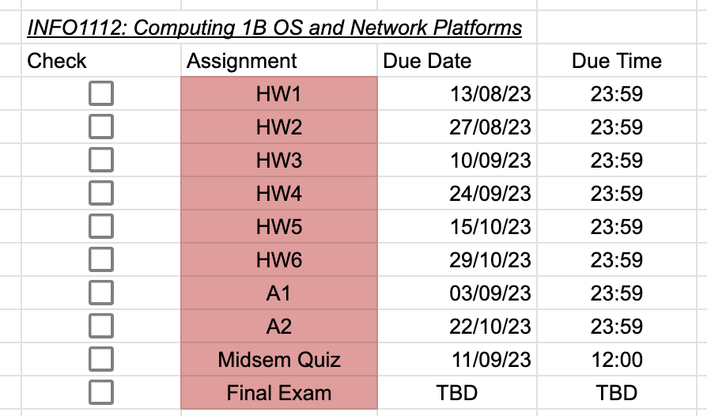
Time Management
In this Unit there will be a lot of deadlines to manage
Therefore, it is important to record all the deadlines right from the start so you will always know when your exams will be.
Assessment Information: https://canvas.sydney.edu.au/courses/53031/pages/assessment-information?module_item_id=2044451
Example Time Management: https://tinyurl.com/34b7j924

Slide 16


Lab exercises
Jump onto Canvas $→$ Modules – under Week 1 you will find today’s lab sheet
We will have some time to work on problems by ourselves
Work through problems at your own pace
Feel free to ask peers/me for help
At certain points, I will go through a few of the questions as well
After you have finished with lab exercises, you can move onto doing homework
Please note: as homework is an assessed task, please only work on your own homework tasks individually
Have fun!

